Slide 1
Bilingual Website
My first bilingual website project.
By: Rose

Slide 2
CONTENTS
Process
Tool
Challenge and Solution
Achievement
Disadvantage
1
2
3
4
5
Overall plan and current progress of the project.
Selection and use of tools.
My challenges and Solutions to this project.
I will show the achievements so far.
Here are some disadvantages about my project.

Slide 3
01
Project process
Overall plan and current progress of the project.

Slide 4
Overall plan
Refine my Chinese website, extend it to a collections of website.
Make some tests about my websites and do some typesetting accordingly.
Extract all the words and make a language package.
QA (Need Mr. Lambson's help!)
01
02
03
04
05
06
07
Make the switch function.
Translate it into English.
Polish my translation and refine the language source package.

Slide 5
Current progress of the project
My language package need to be refined after translating
I haven’t made any tests till now.
Translate it into English.
Refine my Chinese website
Week3
Week 7
Week4
100%
100%
Week1
100%
100%
100%
Week 6
100%
100%
Refine the language source package
Week2
Week 5
Make the switch function
I find my classmate to do the first QA, but I need our teacher’s help.

Slide 6
02
Tools
Selection and use of tools.

Slide 7
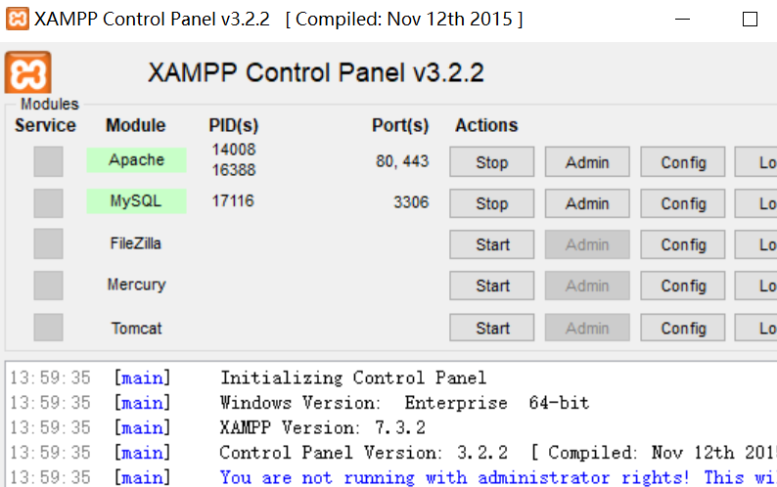
Tools
1 Requirement
Have a programming environment in your own computer.
2 Analysis
The website use html, css and php. So I should have php mode .
3 Choice
XAMPP: XAMPP is the most popular PHP development environment.

Slide 8
Tools
1 Requirement
Write the switch function by myself.
2 Analysis
Must write some codes. So I should choose a useful editor.
3 Choice
Visual Studio Code: Many programmers recommend it as the best tool.

Slide 9

Tools
FTP
Download and upload the website to server.
Need a practical and stable FTP.
XFTP 5: Stable and fast.
Cyberduck: Stable enough but not fast.
LeapFTP: Very fast but not stable

Slide 10
03
Challenge & Solution
My challenges and solutions to this project.

Slide 11
Challenges and Solutions
Writing
Refine my Chinese websites.
Challenge
It is a writing thing.
I have to make it real like a personal website. But I have done all the jobs before.
Solution
So I add some introduction about my projects.
I mind the translation about my project may be a good challenge.

Slide 12
Challenges and Solutions
Choose the way to save English and Chinese texts.
Choice1: Database (Easy to get the texts)
Choice2: Local packages (Need to use regular expressions to extract the text)
Challenge
Solution
Since my website doesn’t have too much texts, I think I should use a simpler way.

Slide 13
Challenges and Solutions
Programming
Make the switch function
Challenge
I haven't ever made such function. So it quite take me some time to code and test it.
Solution
I find some examples on the internet.(Programmers always like to share, that's a tradition.)
I tried many times and apply them into my website.

Slide 14
Challenges and Solutions
Name about each word. I use array to replace each word. So have to name it by using a specific name.
Example: array(title) = “This is a title.”
Meaningful and streamlined.
Don’t be complex.
Challenge
Refer to some language packages.
Solution

Slide 15
04
Achievement
I will show the achievements so far.

Slide 16
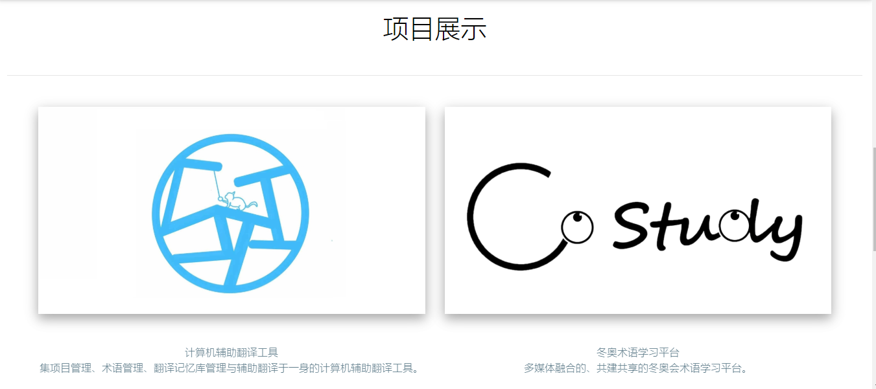
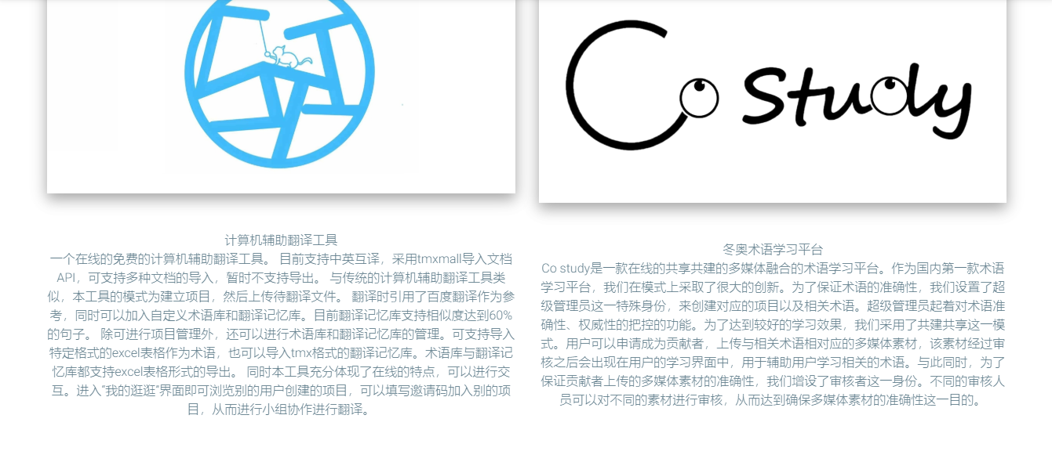
Achievement
Refine my website
Before
After

Slide 17
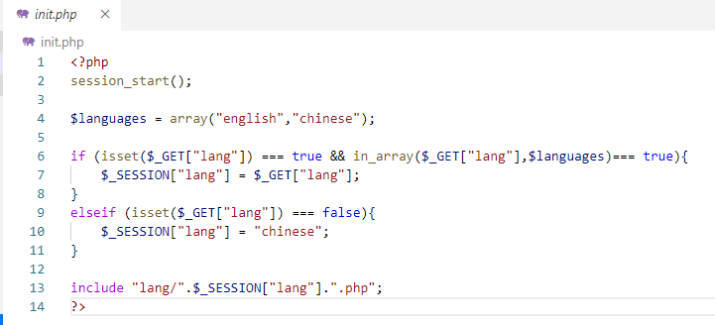
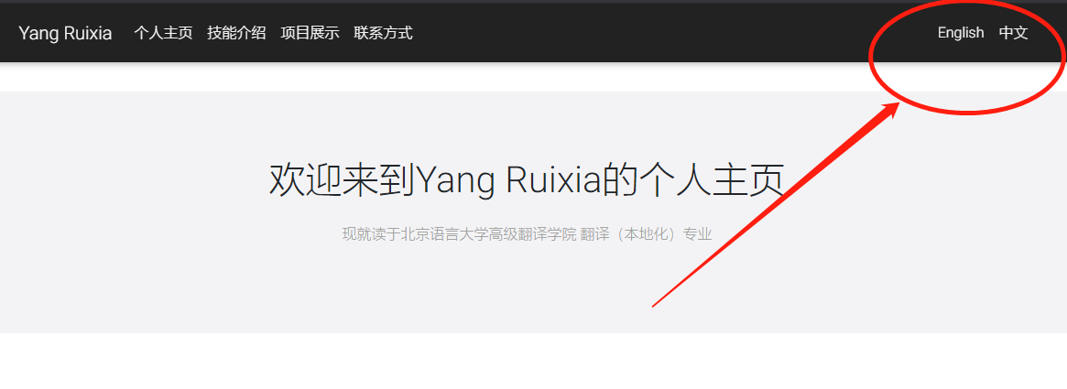
Achievement
The switch function.
Code
Effect

Slide 18
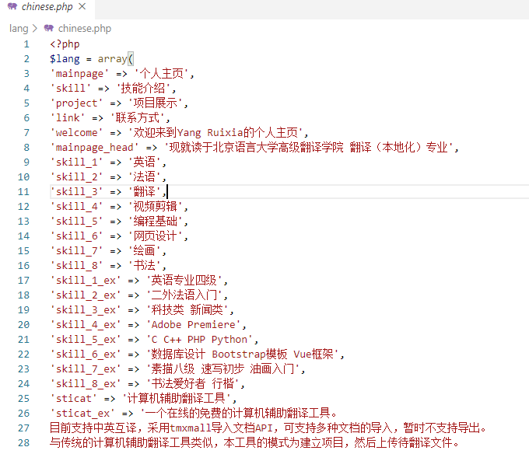
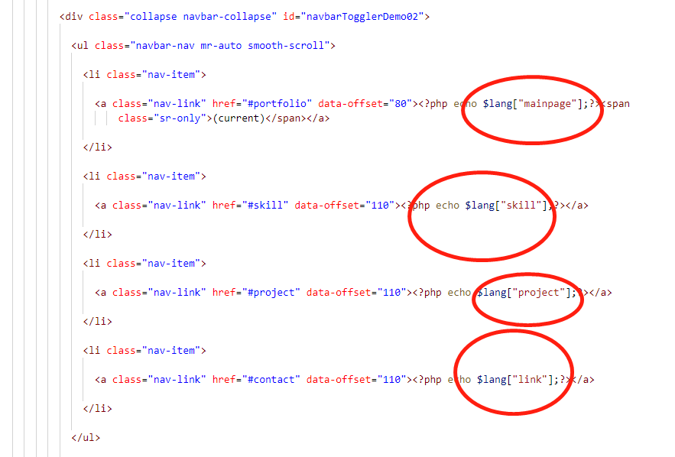
Achievement
Replace the text by array.
Website
Language package

Slide 19
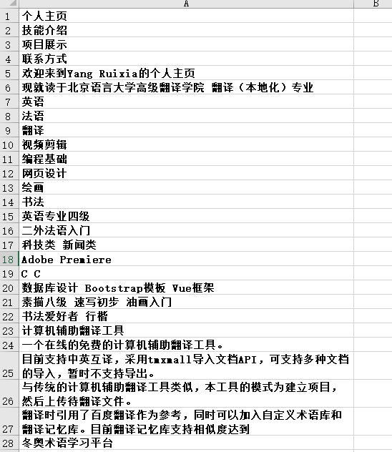
Achievement
Extract the text.
=> ‘[\n A-Za-z\u4e00-\u9fa5\u3002\uff1b\uff0c\uff1a\u201c\u201d\uff08\uff09\u3001\uff1f\u300a\u300b]+’
In website
In excel

Slide 20
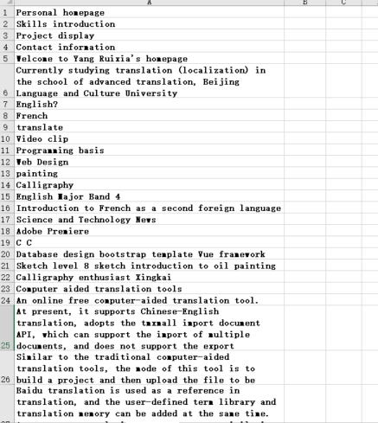
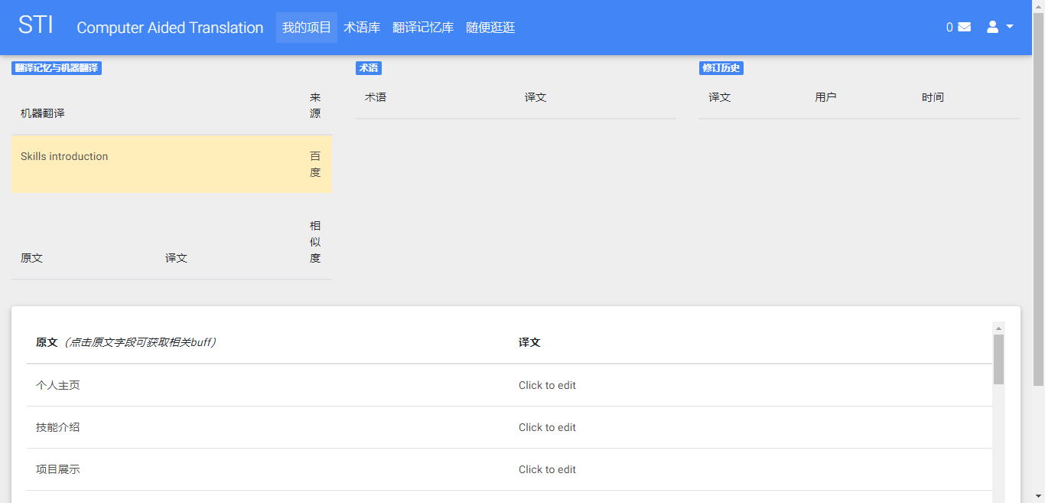
Achievement
Translation

Slide 21
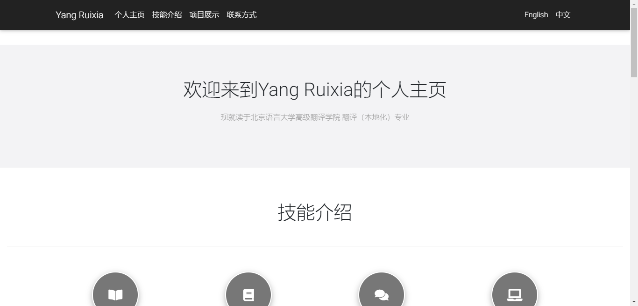
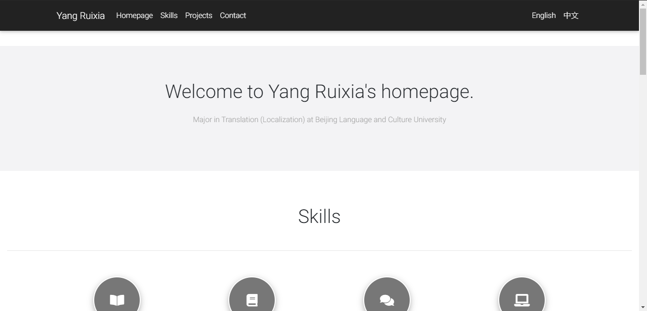
Achievement
Upload and tests.
http://yangruixia.xyz/

Slide 22
05
Disadvantages
Here are some disadvantages about my process.

Slide 23
Disadvantages
Disadvantages?
Details
When I extract texts from my website, I find that it is quite a hardship so that I spend much more time than I have expected.
While my website is not large. What if I deal with a very large website? Is there any automation way? This is the only disadvantage about the process.
The two most important things are:
1: Some words doesn't need to translate. So you must verify the words according to the website.
2: You have to do it by using the most exhausted way. There is no automation technology to extract the words.

Slide 24

Peroration
My harvest
I gain a lot of knowledge in the process. Learn the process about localization. And sometimes I behaved like a programming. Sometimes I am a translator. While I am also the project manager who need to make decision and do the report. That’s quite a challenge.
Thank Mr. Lambson. Thank myself for challenging this localization project.

Slide 25
Thanks
My first bilingual website project.
By: Rose

